Slide 1
Русский язык
俄文(一)
Первый урок
Понедельник, 09/18/2017

Slide 2
Class Requirement
Midterm – 30%
Final exam – 30 %
Participation – 20 %
Attendance – 20 %
This class is not a lecture, your participation is required
Lyubov Cheremisina (Lyuba)
lyubba.taiwan@gmail.com
Mob.: 0955934137

Slide 3
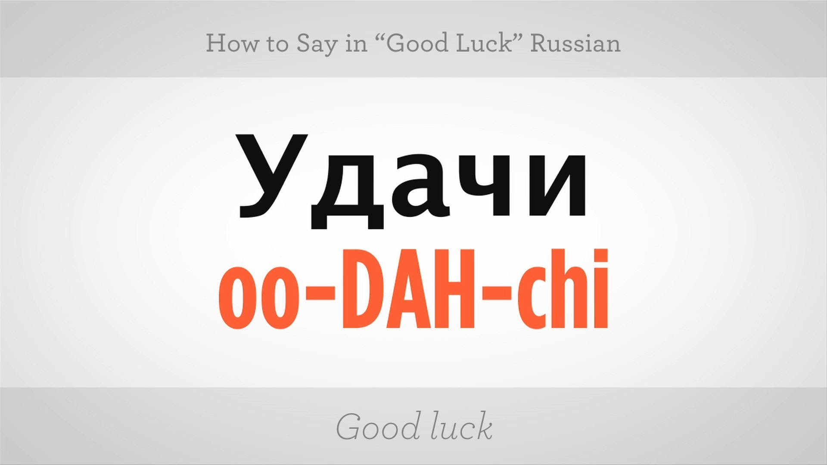

Slide 4
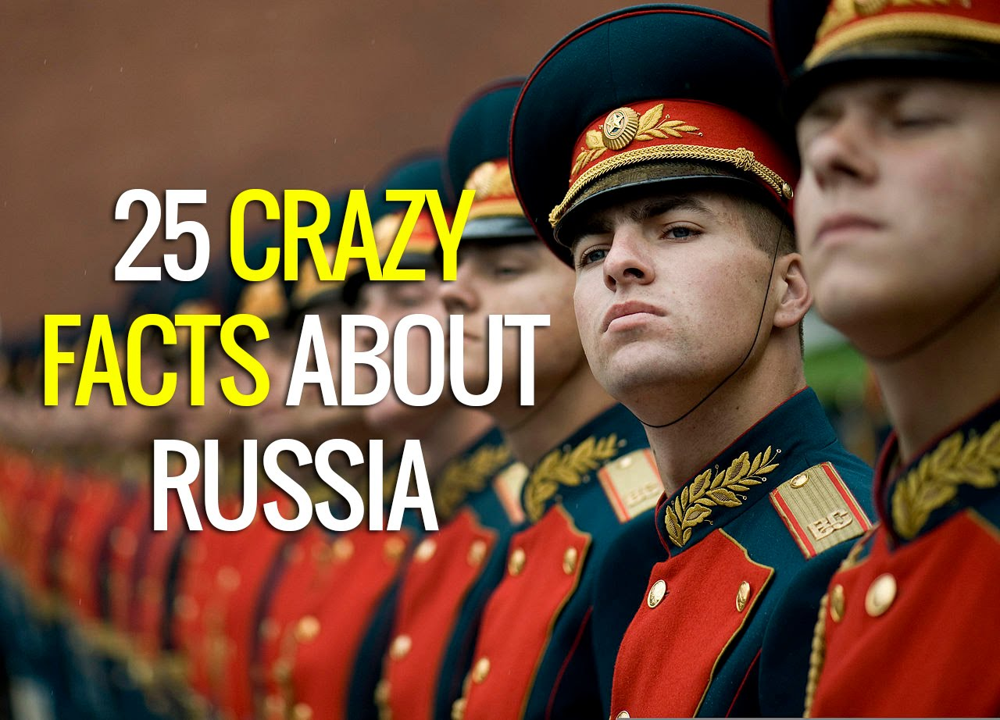
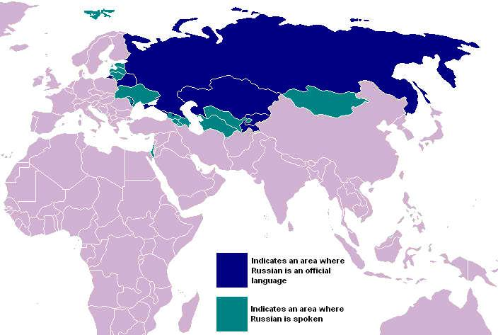
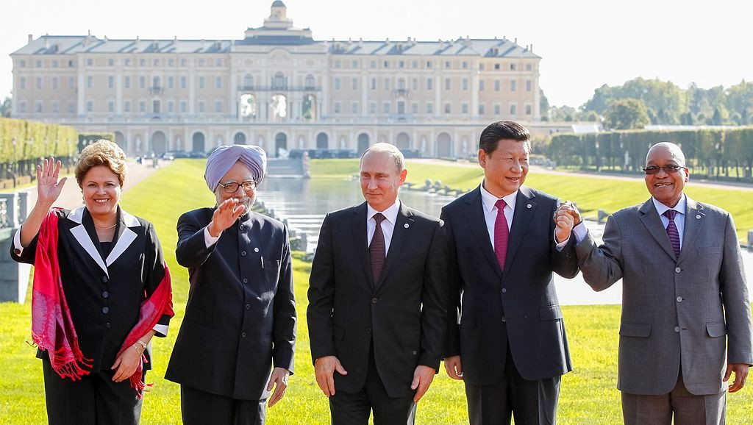
Why study Russian Language?

Slide 5
Facts about Russian Alphabet
The Russian alphabet consists of 33 letters,
20 consonants,
11 vowels
two are signs (the soft sign and the hard sign). Is adopted from the Cyrillic alphabet
(9th century in the First Bulgarian Empire)
The Russian alphabet borrows some letters from Greek and Hebrew.

Slide 6
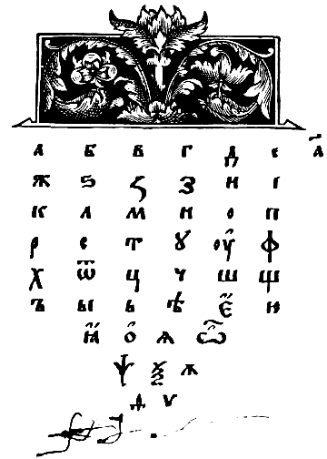
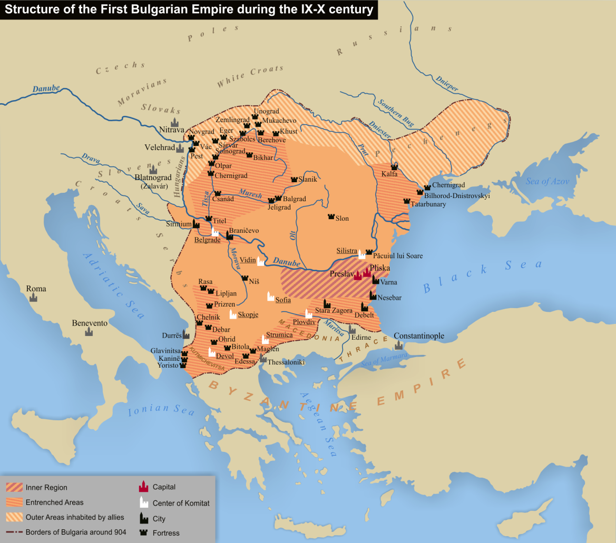

Slide 7
Alphabet
А /a/ | Б /b/ | В /v/ | Г /ɡ/ | Д /d/ | Е /je/ | Ё /jo/ | Ж /ʐ/ | З /z/ | И /i/ | Й /j/
К /k/ | Л /l/ | М /m/ | Н /n/ | О /o/ | П /p/ | Р /r/ | С /s/ | Т /t/ | У /u/ | Ф /f/
Х /x/ | Ц /ts/ | Ч /tɕ/ | Ш /ʂ/ | Щ /ɕː/ | Ъ /-/ | Ы /ɨ/ | Ь /ʲ/ | Э /e/ | Ю /ju/ | Я /ja/

Slide 8
1. The Perfect Matches
There are five Russian that look and pronounced like English alphabet:
A а - pronounced as in "father". It should not be confused with "a" as in "fate" or "map".
K к - pronounced as in "king".
O о - pronounced as "au" in "aura". When unstressed, this letter makes a sound similar to the Russian "A" that you learned above but more reduced, almost like "u" in "under" or the first "o" in "tomato".
T т - pronounced as in "time".
E e - pronounced as "ye" in "yellow".

Slide 9
Practice
Мама - a mother
Кот - a cat
Там - there
Акт - an act
Тома – Toma (short for Tamara (girls name)
-Кто это? Who is it?
-Это Тома. This is Toma

Slide 10
2. The False Friends
The next group of letters includes eight false friends, called so because they look like other English letters or even numbers but have different pronunciation.
В в - pronounced as "v" in "victory“
З з - pronounced as "z" in "zero". Despite similar form, this letter has nothing to do with the number three.
Н н - pronounced as "n" in "noon“
Р р - pronounced as "r" in "bright" (you should roll it like British actors do when reading old poems)
С с - pronounced as "s" in "soup“
У у - pronounced as "oo" in "shoot".
Ч ч - pronounced as "ch" in "chair". This letter is not the number four.
Х х - pronounced as "h" in "hoopla" or "ch" in the Scottish "loch"

Slide 11
Practice
Весна - spring (season)
Ус - moustache
Чек - a check, receipt
Метр - meter
Хвост - tail
Верх – top
Ухо – ear
Нос -nose

Slide 12
3. The Secret Agents
16 letters of the Russian alphabet that we call "secret agents".

Slide 13
Б б - pronounced as "b" in "boy“
Г г - pronounced as "g" in "good“
Д д - pronounced as "d" in "desk“
Ё ё - pronounced as "yo" in "yonder“
Ж ж - pronounced as "s" in "pleasure"
П п - pronounced as "p" in "people"
Ф ф - pronounced as "f" in "fast"
И и - pronounced as "ee" in "feet"
Й й - pronounced as "y" in "boy"
Л л - pronounced as "l" in "last"
Ц ц - pronounced as "ts" in "its"
Ш ш - pronounced as "sh" in “short”
Щ щ - pronounced as "shch" in "bush chat". This letter reminds a combination of "Ш" (sh) and "Ч" (ch).
Э э - pronounced as "e" in "echo"
Ю ю - pronounced as English "you" but shorter
Я я - pronounced as "ya" in "yard"

Slide 14
Practice
Дядя - an uncle
Бой - a battle
Юля - Yulia (female name)
Эти - these
Флаги - flags
Рэп - rap (music)
Ёлка - a fir-tree
Москва – Moscow
Ящик - a box
Ёж - a hedgehog
Шкаф - a cupboard
Цвет - a color

Slide 15
4. The Rare Aves
The last group includes three letters that do not exist in English
Ы ы - pronounced as a combination of two sounds: "i" as in "kit" and "u" as in "sugar“
Ь ь - not pronounced. It is used to make the preceding consonant sound as if a "y" sound was added to it.
Ъ ъ - not pronounced. It is used to signal a slight pause between syllables.

Slide 16
Practice
Быт - everyday life
Рыба - fish
Мы – we
Дым - fog

Slide 17

THANK YOU!
СПАСИБО!

